Slide 1
Joints
Body in Action

Slide 2
Joint definition
A site at which two or more bones come together (articulate) whether or not it allows
movement.
https://www.youtube.com/watch?v=Hmy8XLxcZZo

Slide 3
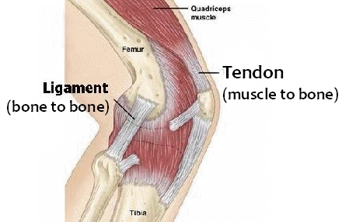
Ligaments & Tendons
• Ligaments: taut inelastic bands of fibrous tissue joining bone to bone.
• Tendons: tough cords of tissue that join muscle to bone.

Slide 4
Mobility & Stability of Joints
Athletes need a balance between mobility and stability.
• Muscle toning adds to the stability of joints
• Mobility depends on:
- muscle bulk
- elasticity of tendons and ligaments
- bone structure of the joint

Slide 5
Flexibility
• Flexibility is the range of motion
around a joint.
• Flexibility can be improved through
exercise.
• Inflexibility may contribute to injury.

Slide 6
Three types of joints

Slide 7
Freely Movable (Synovial) joints
Most common type
Allow the greatest amount of movement
A synovial membrane on the inner layer of the capsule secretes a lubricating fluid known as synovial fluid
Arthritis-
https://www.youtube.com/watch?v=SPbuQtykP3w

Slide 8
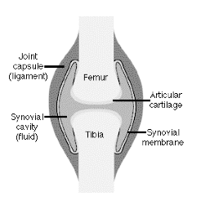
Knee joint

Slide 9
6 types of synovial joints
- gliding: eg. carpal bones
- condyloid: eg. metacarpals and phalanges
- pivot: eg. first two cervical vertebrae
- hinge: eg. ulna and humerus
saddle: eg. carpal-metacarpal joint of the thumb
- ball and socket: eg. pelvis and femur

Slide 10
Joint Movements
https://www.youtube.com/watch?v=5YcNAPzDxDg&t=113s

Slide 11
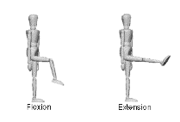
Joint Movements
Flexion :
bending a body part or
decreasing the angle
between the parts
Extension :
straightening a body part
or increasing the angle
between the parts

Slide 12
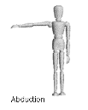
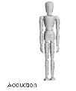
Joint Movements
Abduction :
moving a part of the body
away from the midline
Adduction :
moving a part of the body
toward the midline

Slide 13
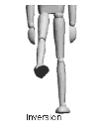
Joint Movements
Inversion :
turning the foot so that the
sole faces inward
Eversion :
turning the foot so that the s
ole faces outward

Slide 14
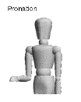
Joint Movements
Supination :
turning the hand so that the
palm faces upward
Pronation :
turning the hand so that the
palm faces downward

Slide 15
Joint Movements
Abduction :
moving a part of the body
away from the midline
Adduction :
moving a part of the body
toward the midline

Slide 16
Joint Movements
Rotation :
turning a body part on an axis. Full 360o
rotation is not possible in a human due to
restriction of muscles, blood vessels and
nerves (e.g. turning the head from side to side)
Circumduction :
a combination of movements which results
in a cone-like movement (e.g. arm circles)

Slide 17
Synovial Joints
Summary of Joints - Hand out

